Slide 1
Introduction to Traceability of Requirements
Objective:
- Understand the concept of traceability and how it applies throughout the Software Development Lifecycle (SDLC).
- Importance of tracking every functional and non-functional requirement from the start to the end of a project.

Slide 2
What is Traceability?
- Traceability is the ability to trace the life of a requirement—from its origin, through its development, to its deployment.
- Ensures that every requirement is accounted for during the design, development, and testing phases.

Slide 3
Key Characteristics of Traceability
- Forward Traceability: Traces requirements to the corresponding design, code, and test cases.
- Backward Traceability: Traces test cases and code back to the original requirements.
- Bidirectional Traceability: Ensures that changes made to requirements are reflected in design, development, and testing.

Slide 4
Why Traceability Matters
- Validation: Helps ensure all customer needs are captured and properly implemented.
- Change Management: Allows for impact analysis when changes are made to requirements.
- Accountability: Maintains a record of who is responsible for each requirement, allowing for better project oversight.

Slide 5
How Traceability Maintains System Integrity
- Ensures that changes do not introduce errors or cause regression issues in the system.
- Especially important in projects where regulatory compliance or safety is paramount.

Slide 6
Example: Cybersecurity Requirement Traceability
Scenario: You have a requirement for data encryption in a financial app.
- Specification: The requirement is documented as 'All customer data must be encrypted using AES-256.'
- Design: Specifies where encryption will be applied (e.g., between the server and client).
- Development: The developers implement the encryption protocol and write unit tests.
- Testing: The testing team verifies that the data is encrypted as per the requirement.

Slide 7
What is a Traceability Matrix?
- A traceability matrix is a tool used to map requirements to their respective stages (design, development, and testing).
- Ensures that every requirement is implemented and tested properly, and no requirements are missed.

Slide 8
Components of a Traceability Matrix
- Requirement ID: A unique identifier for each requirement.
- Design Document: Links to the corresponding design that satisfies the requirement.
- Code Module: Indicates which part of the code implements the requirement.
- Test Cases: Maps the test cases used to verify the requirement.

Slide 9
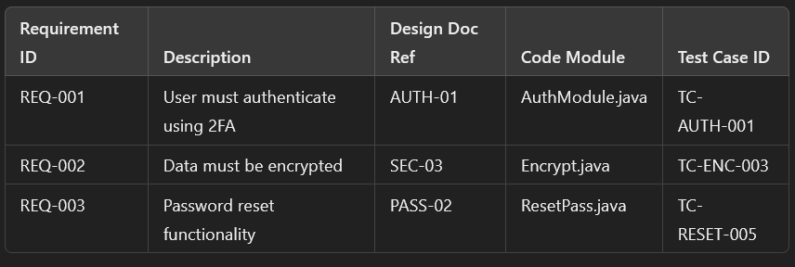
Comprehensive Example of a Traceability Matrix
Scenario: System requirement for user authentication in a mobile banking app.

Slide 10
Introduction to Traceability Tools
- Tools help automate and track requirements, ensuring that traceability is maintained throughout the lifecycle.

Slide 11
Popular Tools for Traceability
- JIRA: Widely used tool for issue and project tracking.
- Confluence: Paired with JIRA for documentation and requirement tracking.
- IBM Rational DOORS: Dedicated requirements management tool for complex systems.

Slide 12
Other Tools
- Polarion: An enterprise-level tool for requirements traceability, used in industries like automotive and medical devices.
- Helix RM: A powerful tool that allows teams to map requirements across the SDLC.

Slide 13
Why Traceability is Crucial in Critical Systems
- In industries like automotive, healthcare, and aviation, traceability is essential due to strict regulatory requirements.
- Ensures that safety and security features comply with regulations like ISO 26262 or FDA guidelines.

Slide 14
Example: Traceability in Automotive Systems (ISO 26262)
- Safety features like emergency braking must be traced from safety requirements through design, development, and testing.
- The traceability matrix ensures compliance with ISO 26262 safety standards.

Slide 15
Comprehensive Example in Healthcare
In a medical device, traceability ensures that requirements for data privacy (HIPAA) are addressed in each stage.
- Privacy protocols like encryption and access control are verified and tested from initial requirement to final testing.

Slide 16
Exercise: Create a Traceability Matrix
Task: Create a traceability matrix for a user registration and login system.
Identify the requirements, design components, and testing steps, and map these in a traceability matrix.

Slide 17
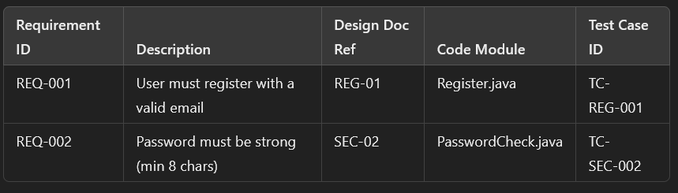
Example of a Traceability Matrix Exercise
Requirement: 'Users must register with a valid email and strong password.'

Slide 18
Key Takeaways
- Traceability is critical for ensuring that all requirements are implemented and tested.
- A traceability matrix helps map requirements to design, development, and testing.
- Tools like JIRA, Confluence, and DOORS make it easier to maintain traceability across the lifecycle.

Slide 19
Requirements Management Standards and Frameworks
- IEEE 830-1998: Software Requirements Specification standard.
Link: https://standards.ieee.org/standard/830-1998.html
- ISO/IEC/IEEE 29148: Systems and software engineering requirements engineering standard.
Link: https://www.iso.org/standard/45171.html
- ISO 26262: Road vehicles – Functional safety.
Link: https://www.iso.org/standard/68383.html

Slide 20
Cybersecurity Standards and Frameworks
- NIST Cybersecurity Framework: A comprehensive guide for managing and reducing cybersecurity risks.
Link: https://www.nist.gov/cyberframework
- MITRE ATT&CK Framework: Knowledge base of adversary tactics and techniques based on real-world observations.
Link: https://attack.mitre.org/
- OWASP Top Ten: The ten most critical web application security risks.
Link: https://owasp.org/www-project-top-ten/

Slide 21
Must-Read Books on Requirements Management
- Wiegers, K. E., & Beatty, J. (2013). *Software Requirements* (3rd ed.). Microsoft Press.
Link: https://www.amazon.com/Software-Requirements-3-Karl-Wiegers/dp/0735679665
- Robertson, S., & Robertson, J. (2012). *Mastering the Requirements Process: Getting Requirements Right* (3rd ed.). Addison-Wesley.
Link: https://www.amazon.com/Mastering-Requirements-Process-Getting-Right/dp/0321815742
- Van Lamsweerde, A. (2009). *Requirements Engineering: From System Goals to UML Models to Software Specifications*. John Wiley & Sons.
Link: https://www.amazon.com/Requirements-Engineering-System-Software-Specifications/dp/0470012706

Slide 22
Tools for Requirements Management & Traceability
- JIRA: Popular tool for managing tasks and requirements with integration into development workflows.
Link: https://www.atlassian.com/software/jira
- IBM Rational DOORS: A dedicated tool for complex requirements management and traceability.
Link: https://www.ibm.com/products/requirements-management
- Polarion: Enterprise-level traceability and requirements management platform.
Link: https://polarion.plm.automation.siemens.com/

Slide 23
Recommended Whitepapers and Professional Articles
- NIST Special Publication 800-53: Security and Privacy Controls for Federal Information Systems.
Link: https://csrc.nist.gov/publications/detail/sp/800-53/rev-5/final
- CISA Cybersecurity Insights: Reports and analysis from the U.S. Cybersecurity and Infrastructure Security Agency.
Link: https://www.cisa.gov/insights
- Automotive Safety Whitepapers: Publications focused on functional safety in automotive software and hardware.
Link: https://www.synopsys.com/automotive/functional-safety.html

Slide 24
Certifications and Online Courses
- Coursera – Software Product Management Specialization: Learn how to manage requirements and traceability in software projects.
Link: https://www.coursera.org/specializations/software-product-management
- Pluralsight – Managing Requirements in Software Development: A comprehensive course covering requirements management and traceability.
Link: https://www.pluralsight.com/courses/requirements-software-development
- Udemy – Cybersecurity and Traceability in Critical Systems: Learn how traceability and cybersecurity are linked in critical system development.
Link: https://www.udemy.com/course/cybersecurity-critical-systems/

Slide 25
Online Communities and Forums
- Agile Alliance: A community focused on Agile best practices, including traceability in Agile projects.
Link: https://www.agilealliance.org/
- OWASP Community: Open-source community for improving software security, including requirements for security traceability.
Link: https://owasp.org/
- Requirements Engineering LinkedIn Group: Join a professional community discussing best practices in requirements engineering and traceability.
Link: https://www.linkedin.com/groups/13266393/

